Slide 1

UNIT-V
SPREAD SPECTRUM TECHNIQUES AND
INFORMATION THEORY CONCEPTS
Session – 8-13
Measures of Information,
Source encoding, Shannon’s channel capacity theorem
Linear block codes
Cyclic codes

Slide 2
Measures of Information
Information is a measure of uncertainty. The less is the probability of occurrence of a certain message, the higher is the information.
Since the information is closely associated with the uncertainty of the occurrence of a particular symbol, When the symbol occurs the information associated with its occurrence is defined as:

Slide 3
Entropy
Entropy is defined in terms of probabilistic behaviour of a source of information
In information theory the source output are discrete random variables that have a certain fixed finite alphabet with certain probabilities
Entropy is an average information content for the given source symbol. (bits/message)

Slide 4
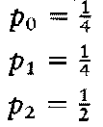
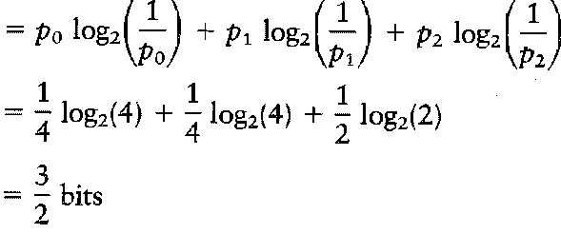
Example
Find the entropy of the source alphabets {S₀,S₁,S₂} with respective probabilities
Solution:
W.K.T ,

Slide 5
Rate of information
If a source generates at a rate of ‘r’ messages per second, the rate of information ‘R’ is defined as the average number of bits of information per second.
‘H’ is the average number of bits of information per message.
Hence, R = rH bits/sec

Slide 6
Source Coding
Source coding (lossless data compression) means that we will remove redundant information from the signal prior the transmission.
Basically this is achieved by assigning short descriptions to the most frequent outcomes of the source output and vice versa.
The common source-coding schemes are
huffman coding
Shannon-Fano Coding
lempel-ziv coding
prefix coding

Slide 7
What is need for source coding ?
For analog sources , the sources coding is related to amplitude distribution and the function of the source waveform.
For discrete sources, the sources coding is related to information content and correlation among the symbols of the source.
Source encoding must satisfy two functional requirements,
1.Efficient representation of data in binary form
2. It must be uniquely decodable.

Slide 8
Source Coding Theorem
Source coding theorem states that the output of any information source having entropy H units per symbol can be encoded into an alphabet having N symbols in such a way that the source symbols are represented by code words having a weighted average length not less than H/log N.
Hence source coding theorem says that encoding of messages from a source with entropy H can be done, bounded by the fundamental information theoretic limitation that the Minimum average number of symbols/message is H/logN.

Slide 9



The average code word length , of source encoder is given as,
- represents average number of bits per source symbol
The code Efficiency is given by,
L_{min} - represents the minimum possible value of
The average code word length for any distortionless source encoding scheme is bounded as

Slide 10
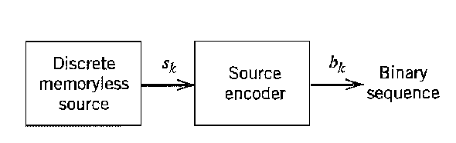
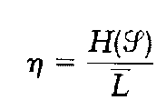
According to source coding theorem, the entropy represents a fundamental limit on the average number of bits per source symbol , but no smaller than the entropy ,Hence we can rewrite the efficiency of a source coder in terms of the entropy as

Slide 11
Huffman Coding
With the Huffman code in the binary case the two least probable source output symbols are joined together, resulting in a new message alphabet with one less symbol
Application : JPEG, MPEG, MP3
ADVANTAGES:
• uniquely decodable code
• smallest average codeword length
DISADVANTAGES:
• LARGE tables give complexity
• sensitive to channel errors

Slide 12
Procedure
Create a list for the symbols, in decreasing order of probability. The symbols with the lowest probability are assigned a ‘0’ and a ‘1’.
These two symbols are combined into a new symbol with the probability equal to the sum of their individual probabilities. The new symbol is placed in the list as per its probability value.
The procedure is repeated until we are left with 2 symbols only for which 0 and 1 are assigned.
Huffman code is the bit sequence obtained by working backwards and tracking sequence of 0’s and 1’s assigned to that symbol and its successors.

Slide 13
Huffman Coding: Example
Source Symbol sk | Symbol Probability pk
s0 | 0.1
s1 | 0.2
s2 | 0.4
s3 | 0.2
s4 | 0.1

Slide 14
Solution
Source
Symbol
sk
s2
s1
s3
s0
s4
Stage I
0.4
0.2
0.2
0.1
0.1

Slide 15


Solution
Stage II
0.4
0.2
0.2
0.2
Source
Symbol
sk
s2
s1
s3
s0
s4
Stage I
0.4
0.2
0.2
0.1
0.1

Slide 16


Solution
Source
Symbol
sk
s2
s1
s3
s0
s4
Stage I
0.4
0.2
0.2
0.1
0.1
Stage II
0.4
0.2
0.2
0.2
Stage III
0.4
0.4
0.2

Slide 17

Solution
Source
Symbol
sk
s2
s1
s3
s0
Stage I
0.4
0.2
0.2
0.1
Stage II
0.4
0.2
0.2
0.2
Stage III
0.4
0.4
0.2
Stage IV
0.6
0.4
s4
0.1

Slide 18
Solution
Source
Symbol
sk
s2
Stage I
0.4
Stage II
0.4
Stage III
0.4
Stage IV
0.6
0
s1
0.2
0.2
0.4
0
0.4
1
s3
0.2
0.2
0
0.2
1
s0
s4
0.1
0.1
0
1
0.2
1

Slide 19
Solution
Source
Symbol
sk
s2
Stage I
0.4
Stage II
0.4
Stage III
0.4
Stage IV
0.6
Code
00
0
s1
0.2
0.2
0.4
0
0.4
10
1
s3
0.2
0.2
0
0.2
11
1
s0
s4
0.1
0.1
0
1
0.2
010
011
1

Slide 20
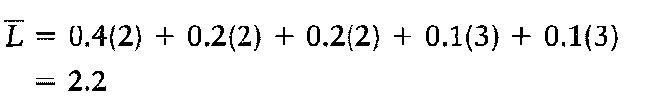
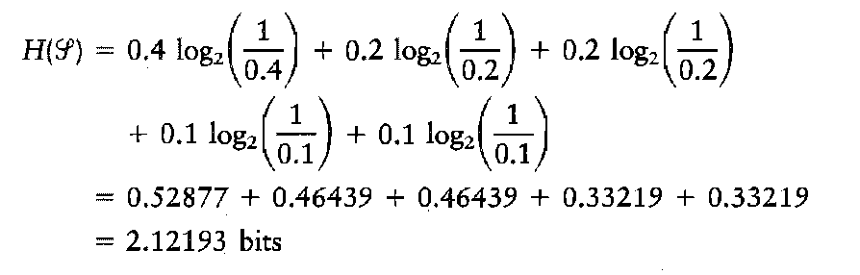
The average code word length is,
The entropy is,

Slide 21
Exercise
Find Huffman code for the following source
Symbol | Probability
h | 0.1
e | 0.1
l | 0.4
o | 0.25
w | 0.05
r | 0.05
d | 0.05

Slide 22
Shannon-Fano Coding
In Shannon–Fano coding, the symbols are arranged in order from most probable to least probable, and then divided into two sets whose total probabilities are as close as possible to being equal.
All symbols then have the first digits of their codes assigned; symbols in the first set receive "0" and symbols in the second set receive "1".
As long as any sets with more than one member remain, the same process is repeated on those sets, to determine successive digits of their codes.
When a set has been reduced to one symbol, of course, this means the symbol's code is complete and will not form the prefix of any other symbol's code.

Slide 23
Shannon’s Channel Coding theorem
The Shannon theorem states that given a noisy channel with channel capacity C and information transmitted at a rate R, then if R < C there exist codes that allow the probability of error at the receiver to be made arbitrarily small.
This means that theoretically, it is possible to transmit information nearly without error at any rate below a limiting rate, C.
The converse is also important. If R > C, an arbitrarily small probability of error is not achievable.
All codes will have a probability of error greater than a certain positive minimal level, and this level increases as the rate increases.
So, information cannot be guaranteed to be transmitted reliably across a channel at rates beyond the channel capacity.

Slide 24
Shannon Coding: Example
A discrete memoryless source has six source symbols S0, S1, S2, S3, S4 and S5 with their probability assignments P(S0) = 0.30, P(S1) = 0.25, P(S2) = 0.20, P(S3) = 0.12, P(S4) = 0.08 and P(S5) = 0.05. Encode the source with Shannon-Fano codes. Calculate its efficiency.

Slide 25
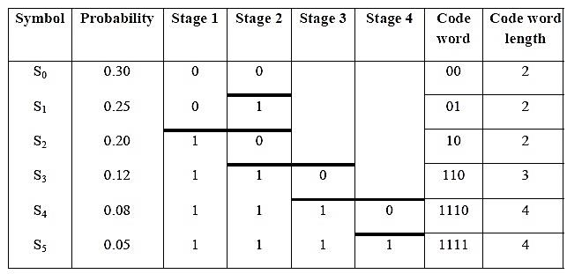
Solution

Slide 26
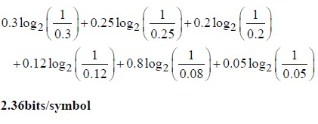

The average code word length is,
= 0.30 (2) + 0.25 (2) + 0.20 (2) + 0.12(3) + 0.08(4) + 0.05(4)
= 2.38 bits/symbol
The entropy is,
=
=
=

Slide 27
Linear Block Codes
Channel Coding
Why?
To increase the resistance of digital communication systems to channel noise via error control coding
How?
By mapping the incoming data sequence into a channel input sequence and inverse mapping the channel output sequence into an output data sequence in such a way that the overall effect of channel noise on the system is minimized
Redundancy is introduced in the channel encoder so as to reconstruct the original source sequence as accurately as possible.

Slide 28
The implication of Error Control Coding
Addition of redundancy implies the need for increased transmission bandwidth
It also adds complexity in the decoding operation
Therefore, there is a design trade-off in the use of error-control coding to achieve acceptable error performance considering bandwidth and system complexity.
Types of Error Control Coding
Linear Block codes
Convolutional codes

Slide 29
Linear Block Codes
An (n,k) block code indicates that the codeword has n number of bits and k is the number of bits for the original binary message
A code is said to be linear if any two code words in the code can be added in modulo-2 arithmetic to produce a third code word in the code

Slide 30
Linear Block Codes
Codes in which the message bits are transmitted in an unaltered form.
Example : Consider an (n,k) linear block code
There are 2^{k} number of distinct message blocks and 2^{n} number of distinct code words
Let m₀,m₁,….m_{k-1} constitute a block of k-bits binary message
By applying this sequence of message bits to a linear block encoder, it adds n-k bits to the binary message
Let b₀,b₁,….b_{n-k-1} constitute a block of n-k-bits redundancy
This will produce an n-bits code word
Let c₀,c₁,….c_{n-1} constitute a block of n-bits code word
Using vector representation they can be written in a row vector notation respectively as
(c₀ c₁ …. c_{n} ) , (m₀ m₁ …. m_{k-1} ) and (b₀ b₁ …. b_{n-k-1} )

Slide 31
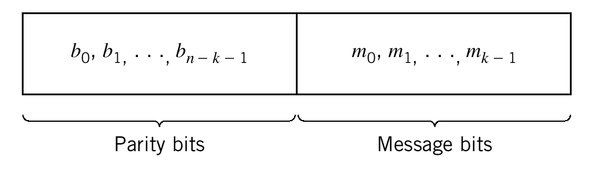
Linear Block Codes
Using matrix representation, we can define
c, the 1-by-n code vector = [c₀ c₁ …. c_{n} ]
m, the 1-by-k message vector =[m₀ m₁ …. m_{k-1} ]
b, the 1-by-(n-k) parity vector = [b₀ b₁ …. b_{n-k-1} ]
With a systematic structure, a code word is divided into 2 parts. 1 part occupied by the binary message only and the other part by the redundant (parity) bits.
The (n-k) left-most bits of a code word are identical to the corresponding parity bits
The k right-most bits of a code word are identical to the corresponding message bits

Slide 32
Linear Block Codes
In matrix form, we can write the code vector,c as a partitioned row vector in terms of vectors m and b
c=[b m]
Given a message vector m, the corresponding code vector, c for a systematic linear (n,k) block code can be obtained by a matrix multiplication
c=m.G
Where G is the k-by-n generator matrix.

Slide 33
Linear Block Codes
The generator matrix, G
G, the k-by-n generator matrix has the general structure
G = [I_{k} P]
Where I_{k} is the k-by-k identity matrix and
P is the k-by-(n-k) coefficient matrix
1 | 0 | …. | 0
0 | 1 | …. | 0
0 | 0 | …. | 1
P₀₀ | P₀₁ | ….. | P_{0,n-k-1}
P₁₀ | P₁₁ | ….. | P_{1,n-k-1}
P_{k-1, 0} | P_{k-1,1} | ….. | P_{k-1,n-k-1}
I_{k}=
P =
The identity matrix simply reproduces the message vector for the first
k elements of c
The coefficient matrix generates the parity vector,b via b=m.P
The elements of P are found via research on coding.

Slide 34
Cyclic Codes
A subclass of linear codes having a cyclic structure.
The code vector can be expressed in the form
c = ( c_{n-1} c_{n-2} ……c₁ c₀ )
A new code vector in the code can be produced by cyclic shifting of another code vector.
For example, a cyclic shift of all n bits one position to the left gives
c’ = ( c_{n-2} c_{n-3} ……c₁ c₀ c_{n-1})
A second shift produces another code vector, c”
c” = ( c_{n-3} c_{n-4} ……c₁ c₀ c_{n-1} c_{n-2})

Slide 35
Cyclic Codes
The cyclic property can be treated mathematically by associating a code vector, c with the code polynomial, c(X)
c(X) = c₀ + c₁X + c₂X²+……c_{n-1}X^{n-1}
The power of X denotes the positions of the codeword bits.
The coefficients are either 1s and 0s.
An (n,k) cyclic code is defined by a generator polynomial, g(X)
g(X) = X^{n-k} + g_{n-k-1}X^{n-k-1} + ……. + g₁X + 1
The coefficient g are such that g(X) is a factor of X^{n} + 1

Slide 36
Cyclic Codes – Encoding Procedure
To encode an (n,k) cyclic code
Multiply the message polynomial , m(X) by X^{n-k}
Divide X^{n-k}.m(X) by the generator polynomial, g(X) to obtain the remainder polynomial, b(X)
3. Add b(X) to X^{n-k.}m(X) to obtain the code polynomial

Slide 37
Cyclic Codes - Example
The (7,4) Hamming Code
For message sequence 1001
The message polynomial, m(X) = 1 + X³ (1001)
1. Multiply by X^{n-k} (X³) gives X³ + X⁶
2. Divide by the generator polynomial, g(X) that is a factor of X^{n} + 1
For the (7,4) Hamming code is defined by its generator polynomials, g(X) that are factors of X⁷ + 1
With n =7, we can factorize X⁷ + 1 into three irreducible polynomials
X⁷ + 1 = (1 + X)(1 + X² + X³)(1 + X + X³)

Slide 38
Cyclic Codes - Example
For example we choose the generator polynomial, 1 + X + X³ and perform the division we get the remainder, b(X) as X² + X (011)
3. Add b(X) with X³ + X⁶ to obtain the code polynomial, c(X)
c(X) = X + X² + X³ + X⁶
So the codeword for message sequence 1001 is 0111001

Slide 39
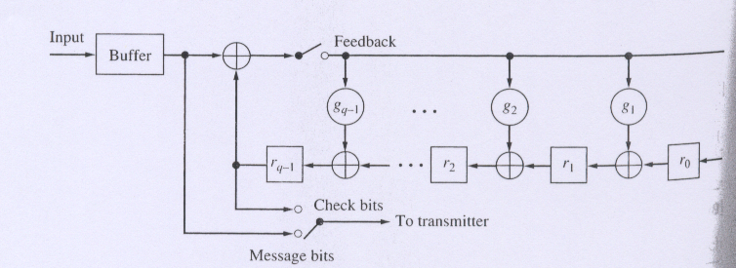
Cyclic Codes – Implementation
The Cyclic code is implemented by the shift-register encoder with (n-k) stages
r_{n-k-1}
Encoding starts with the feedback switch closed, the output switch in the message bit position, and the register initialized to the all-zero state.
The k message bits are shifted into the register and delivered to the transmitter.
After k shift cycles, the register contains the b check bits.
The feedback switch is now opened and the output switch is moved to the check bits to deliver them to the transmitter.

Slide 40
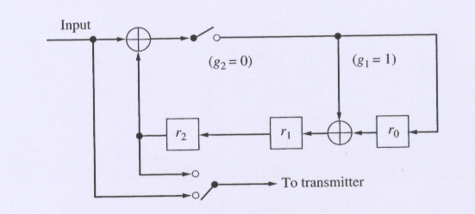
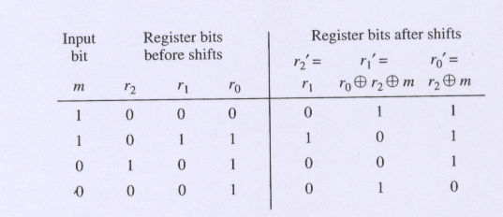
Cyclic Codes – Implementation example
The shift-register encoder for the (7,4) Hamming Code has (7-4=3) stages
When the input message is 0011, after 4 shift cycles the redundancy bits are delivered

Slide 41
Cyclic Codes – Implementation Exercise
The shift-register encoder for the (7,4) Hamming Code has (7-4=3) stages
When the input message is 1001, after 4 shift cycles the redundancy bits are delivered
1
The check bits
is 011
0
0
0
0
1
1
0
0
1
1
1
1
0
0
1
1
0
1
1
1
1
1
1
1
1
1
0

Slide 42
References
Simon Haykin and Michael Moher, “Communication Systems,” 5th edition, John Wiley & Sons, 2013.
Singh. R. P & Sapre. S. D, “Communication Systems: Analog & Digital,” 3rd edition, McGrawHill Education, Seventh Reprint, 2016.

